Slide 1
Different Learning Methods for Machine-Generated Text Detection
Ng Man Tik
1155158302

Slide 2


Inspiration
This project is inspired by two things
Development of various online tools designed to detect machine-generated text. (e.g. Veriguide)
Rise of LLM (GPT3.5, GPT4 …), some can generate sophisticated and human-like results.

Slide 3
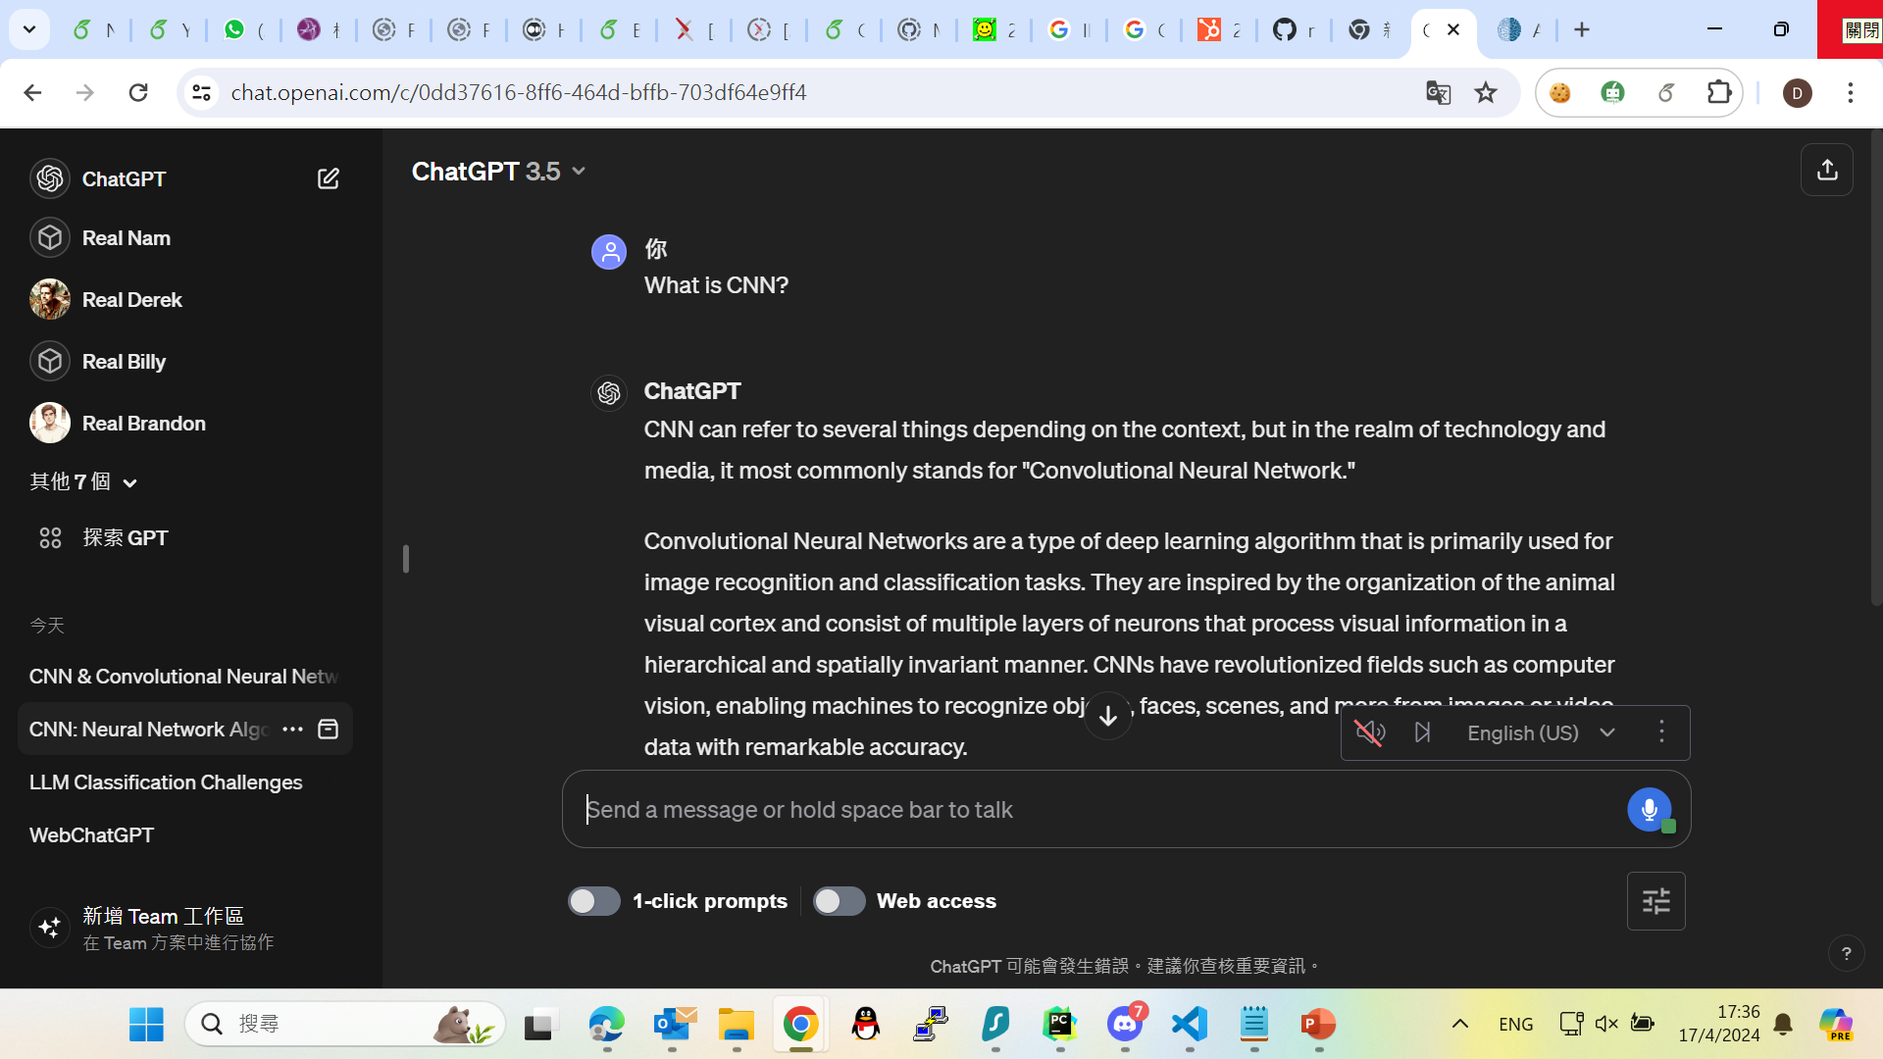
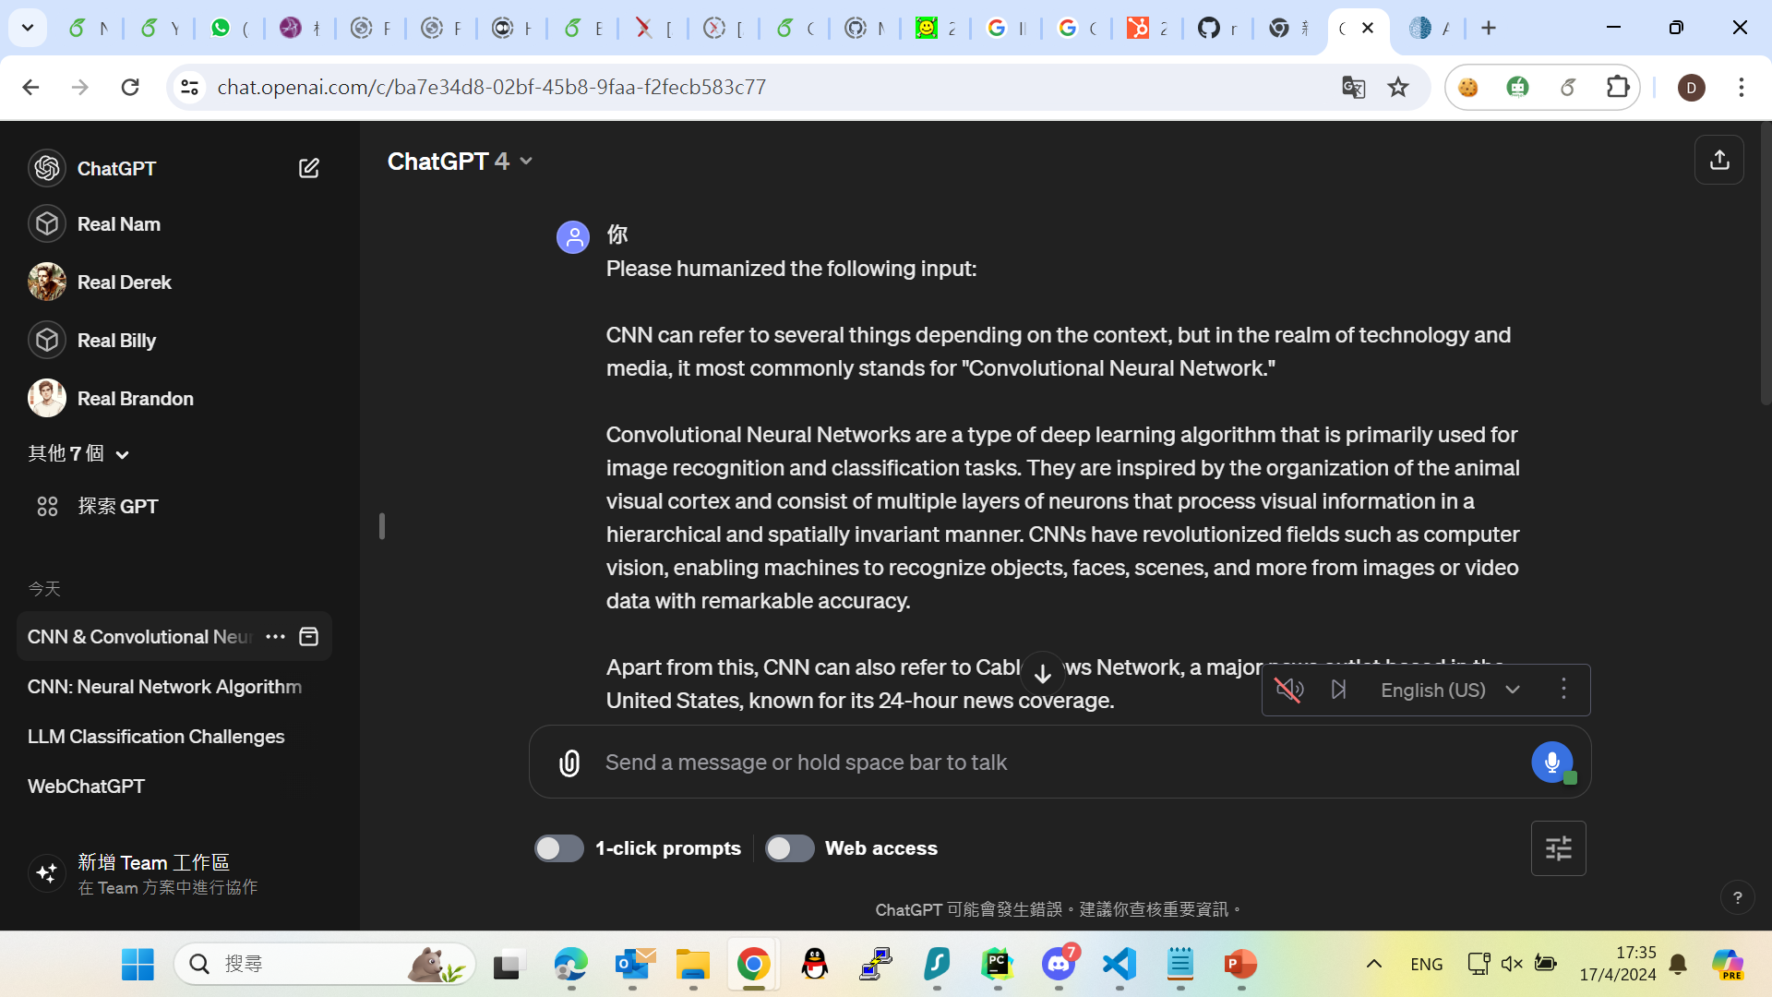
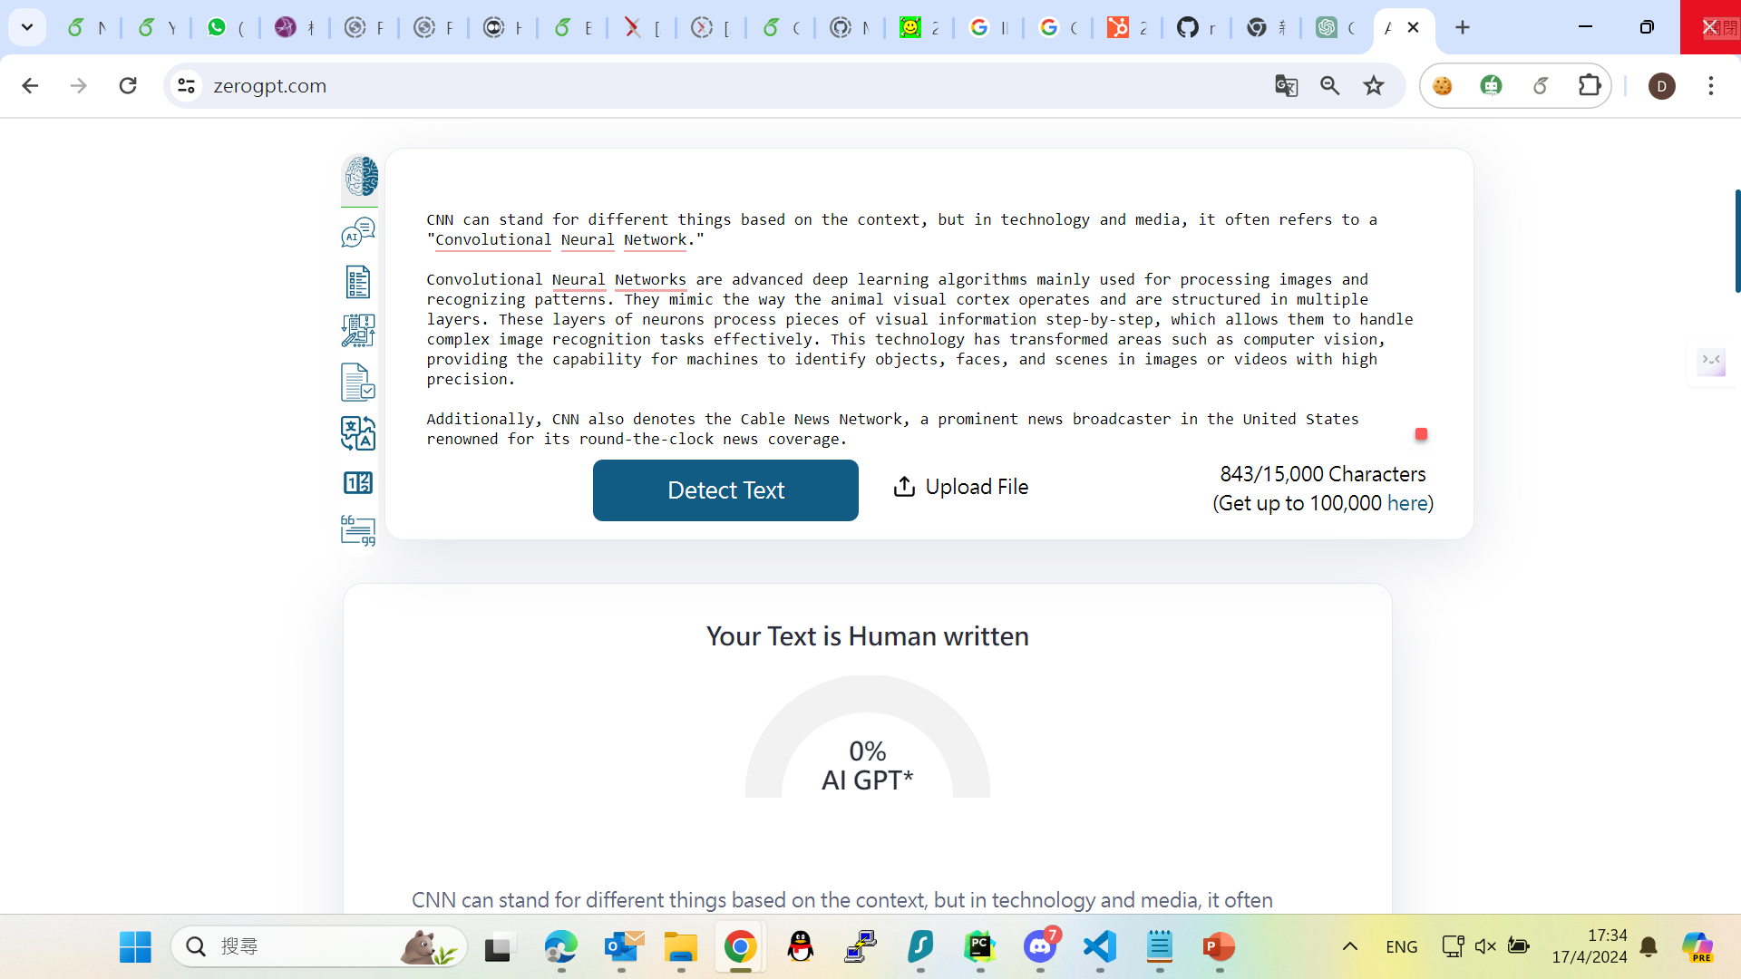
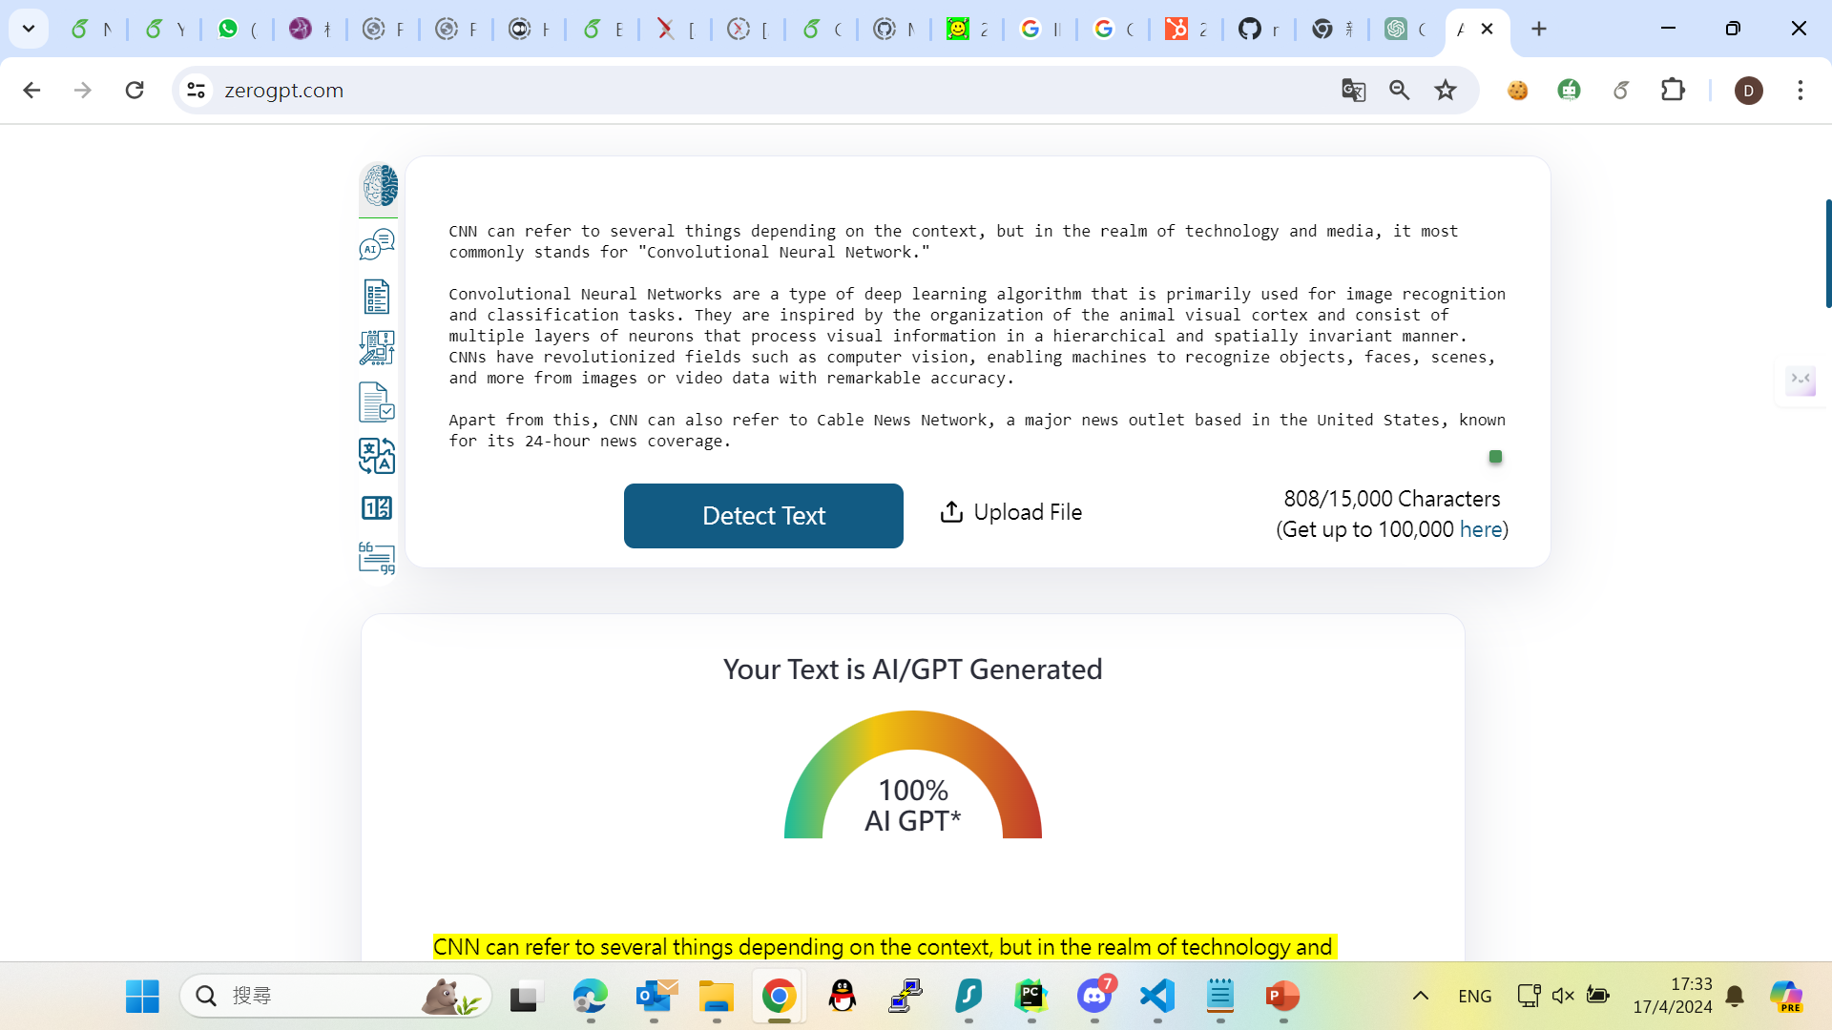
Direct Generation
After GPT4 Processing

Slide 4
Goal
In this project, there are few questions want to solve:
Can those models detect the trending LLM generated data well?
Would they mislabel the HWT into MGT?
Are there any performance difference in detecting the pure data and mixed data?
Training different models with Machine-generated text (MGT) and Human-written text (HWT).
Goal is to label the result as 0 (HWT) or 1 (MGT) in the testing set.

Slide 5
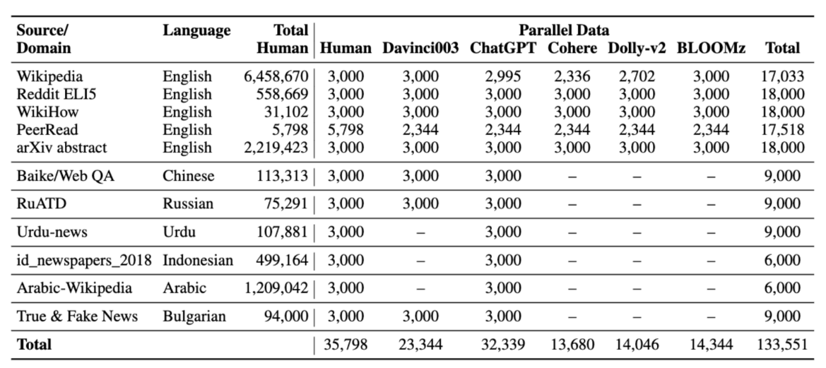
M4 Dataset
Designed for the detection of MGT across multiple generators, domains, and languages.
Focus on multiple generators and domains only.
Model chosen: Human, Davinci003, ChatGPT, Cohere
Domain Chosen: Wiki, Reddit, WikiHow, PeerRead, arXiv
Used for training + testing

Slide 6
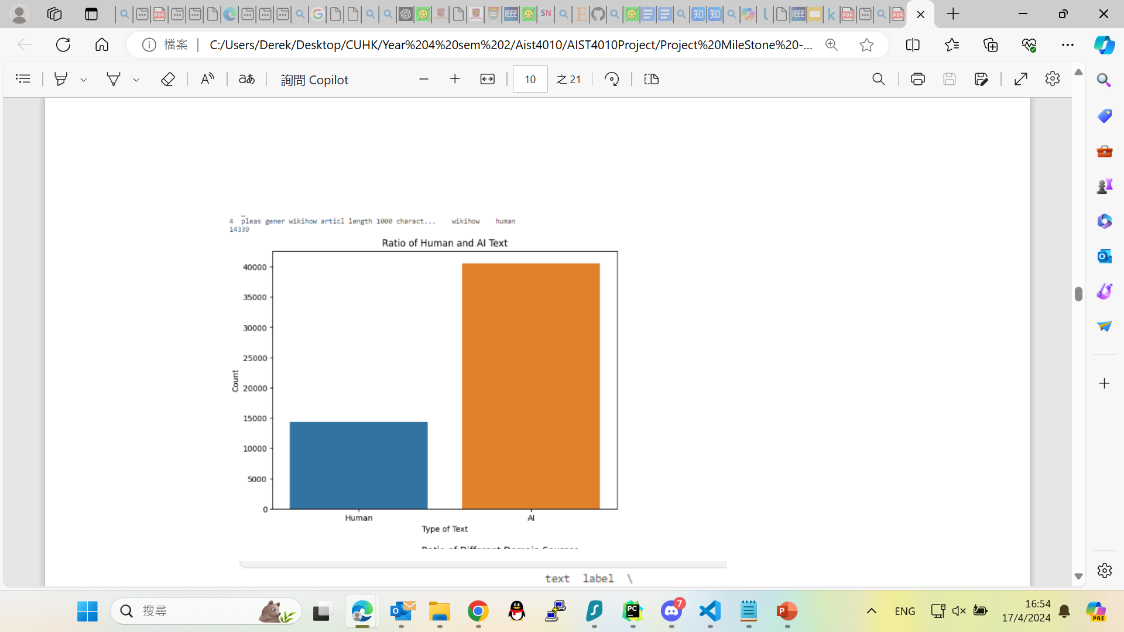
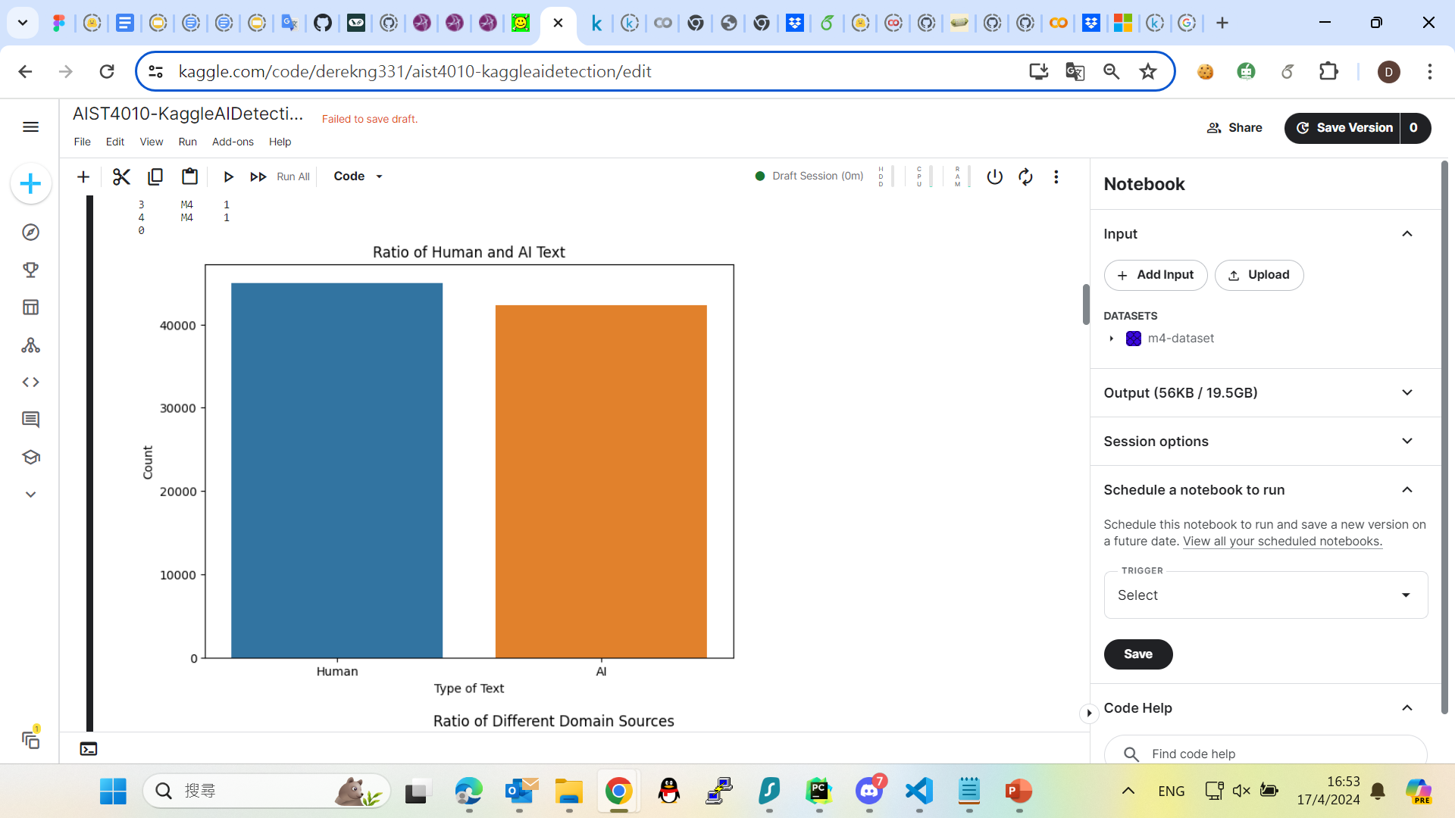
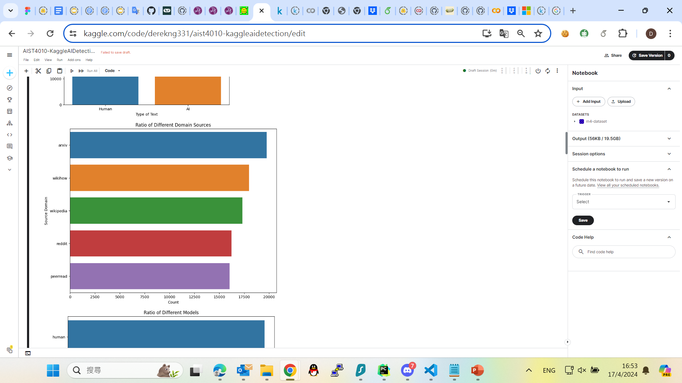
M4 Dataset
There’s an imbalance between HWT and MGT, which affect the training result
Perform oversampling to make the dataset more balanced.
Total Size: Around 85k
Original
Current

Slide 7
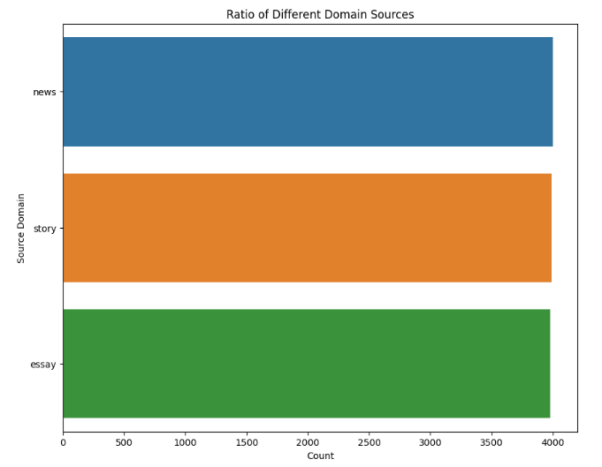
MGTBench Dataset
Testing the performance in 1. Different Domain 2. Different machine generator.
Underlined ones are out-of-distribution data.
Domain: News, Story, Essay
Model: ChatGPT, GPT4, Human
Size: 12k

Slide 8
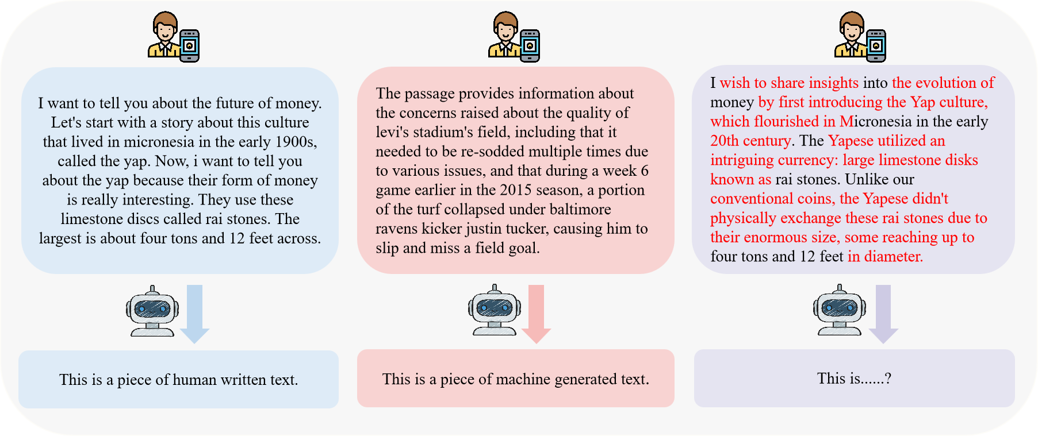
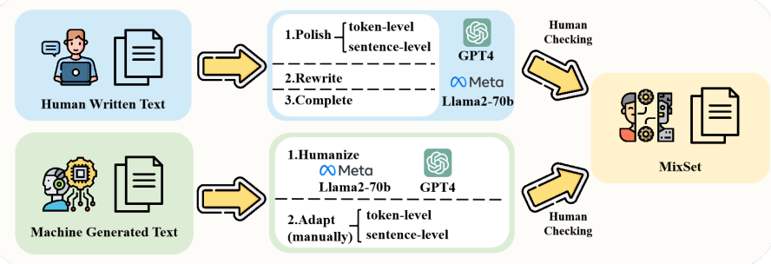
MixSet Dataset
A dataset featuring a blend of HWT and MGT.
Consist of 4 mixing methods:
Polish: alternating in word / sentence level
Complete: Completing the remaining 2/3 from original 1/3 data
Rewrite: extract key information and rewrite
Humanize: Modifying to mimic human writing

Slide 9
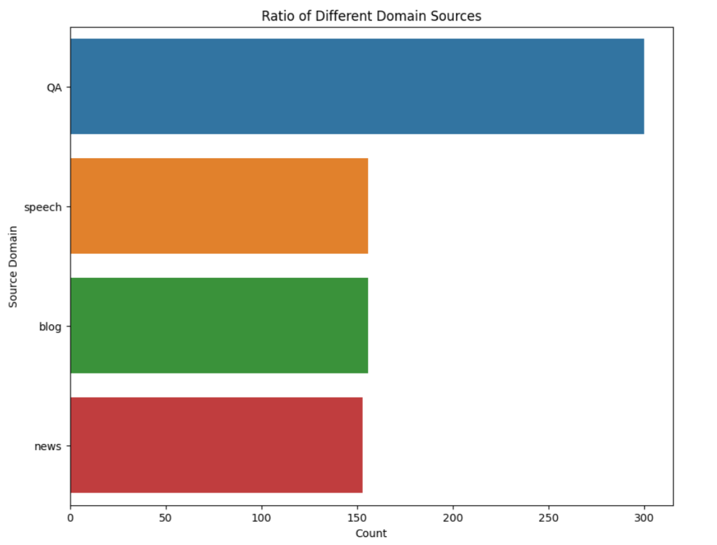
MixSet Dataset
Test model performance on mixed data.
Extract only the data mixed by GPT4 only.
Size: 750
Classification goal: Labeling the same as the original text.
Method | Correct Criteria
Polish | HGT / 0
Rewrite | HGT / 0
Complete | HGT / 0
Humanize | MGT / 1

Slide 10
Model Choice
Evaluate the BiLSTM model and variants combining CNNs and Attention
Role of BiLSTM: Captures long-range dependencies within the text in both directions, which can understand more complex sentence structures.
Role of CNN: Extracts the features from the text data for understanding local context.
Role of Attention: Focusing on the most relevant parts of the text for making a detection decision.
Also using SVM (with TF-IDF) with Poly kernel as baseline.

Slide 11
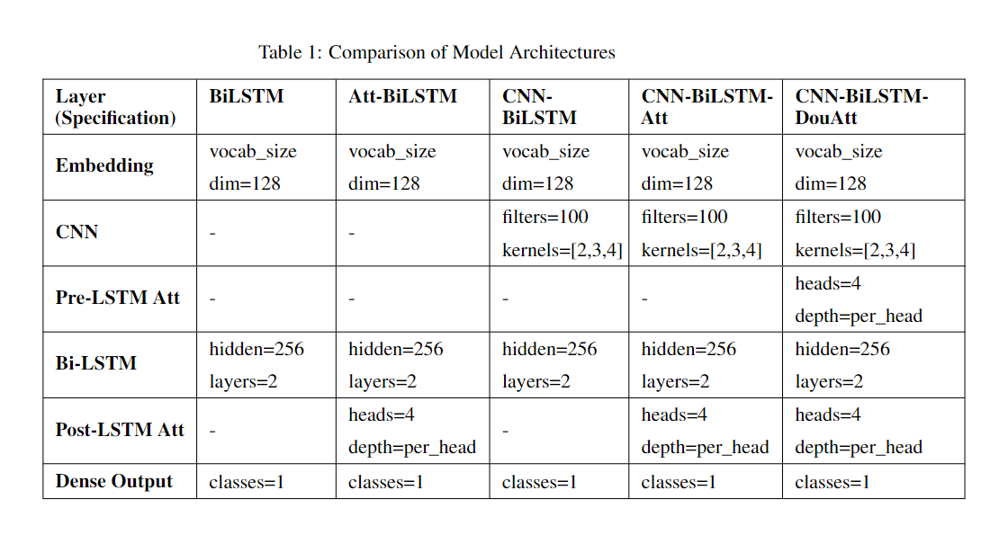
Comparison

Slide 12
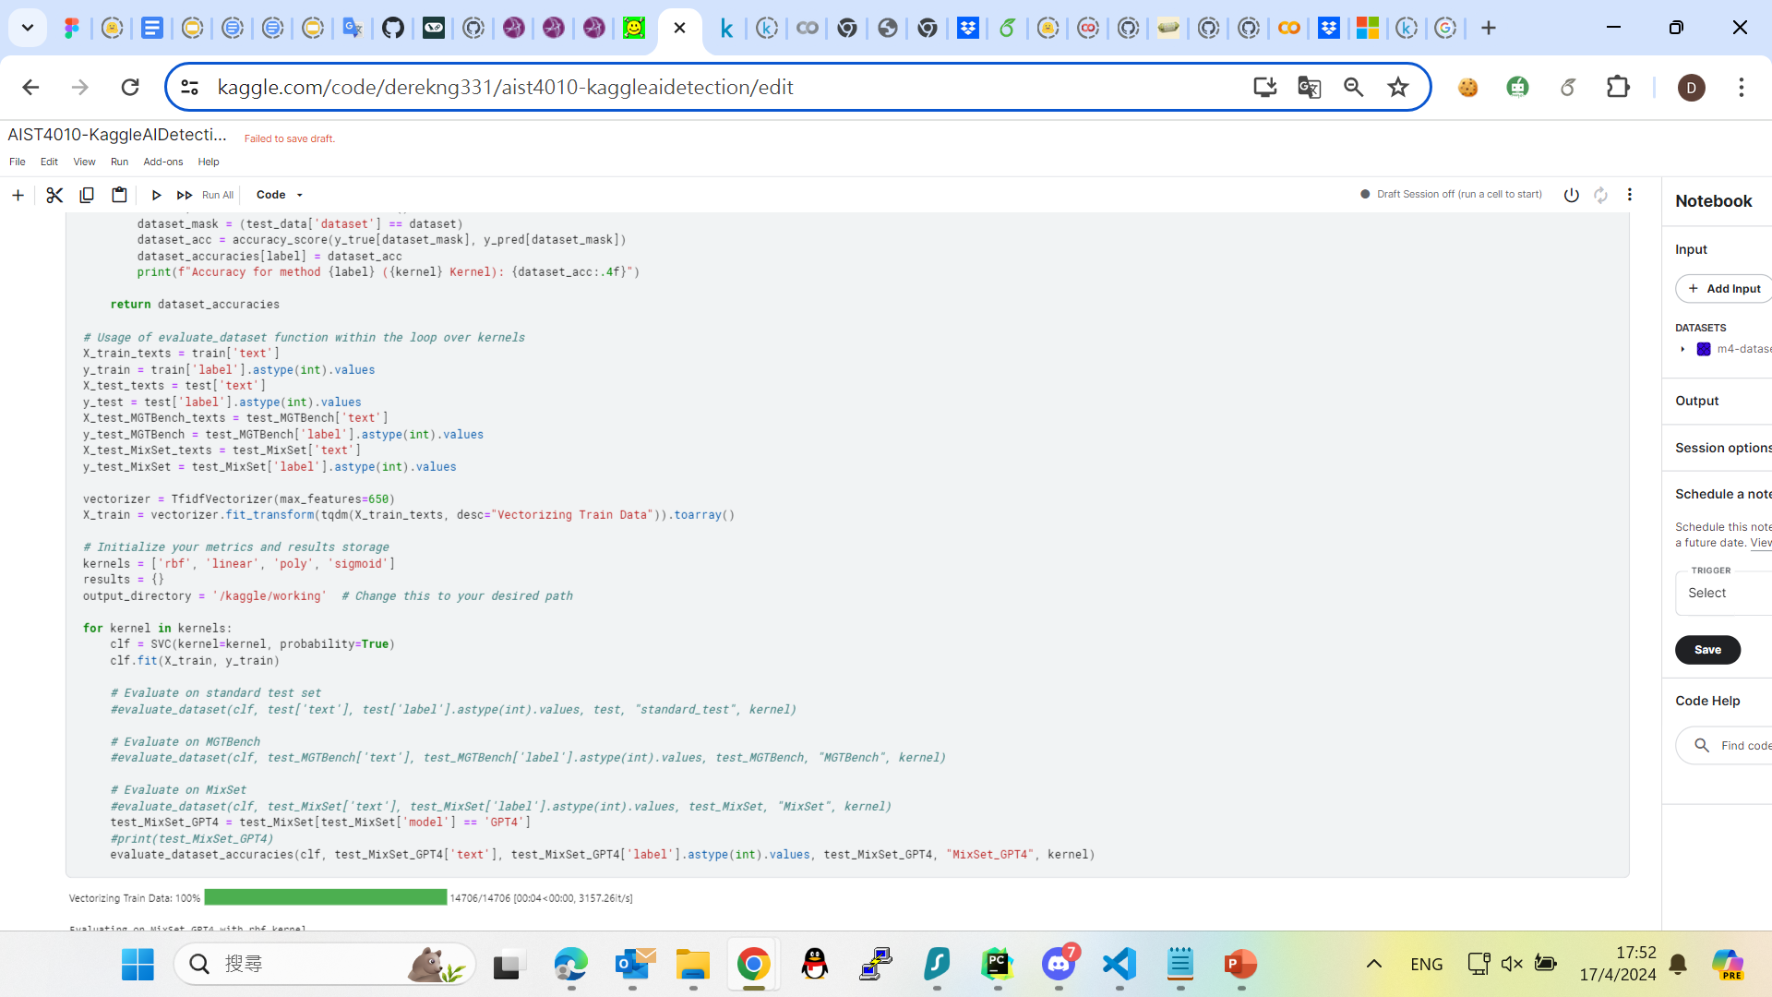
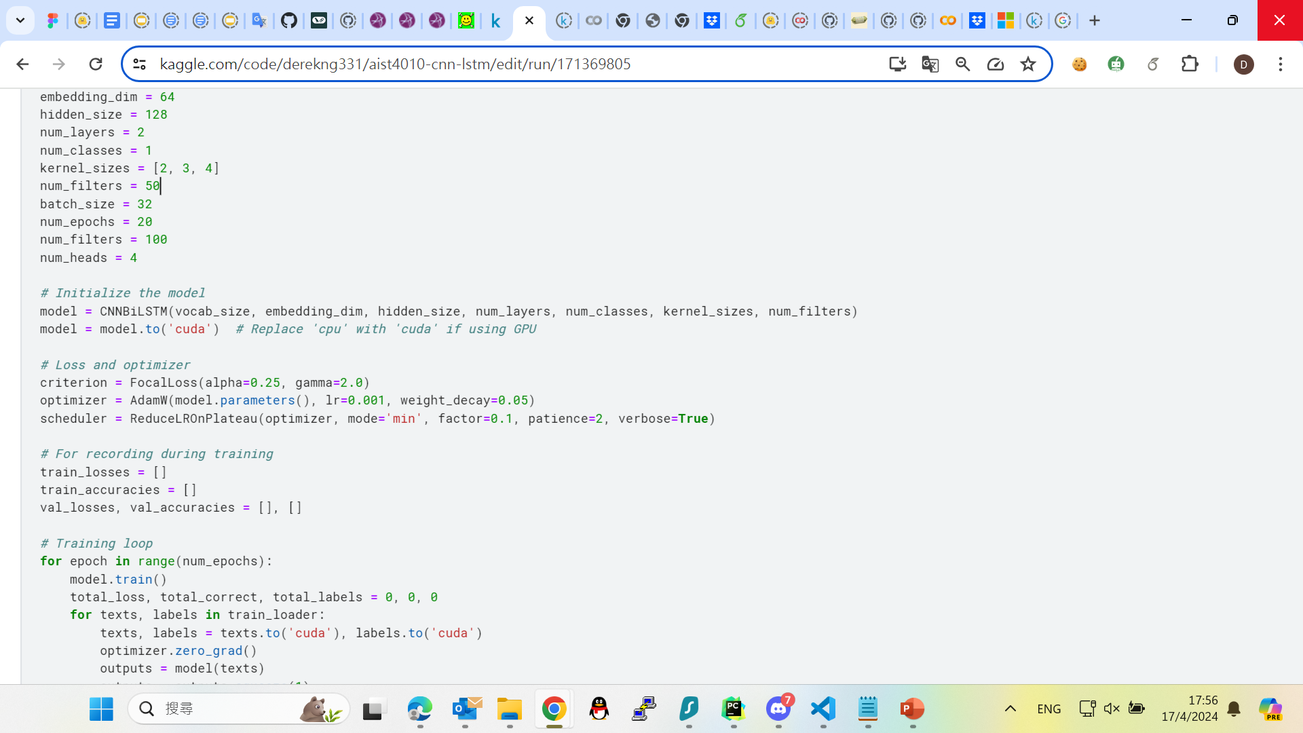
Train Setting
SVM: Setting Tf-IDF only
BiLSTM series: all training for 8 epochs

Slide 13
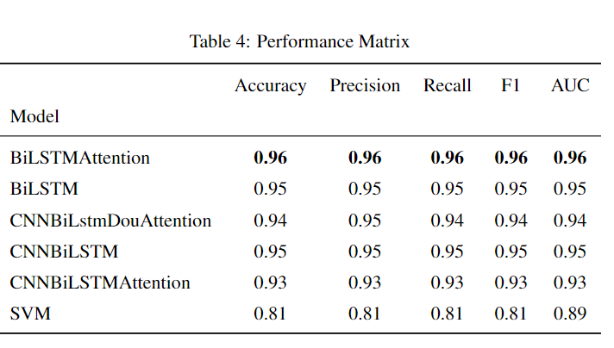
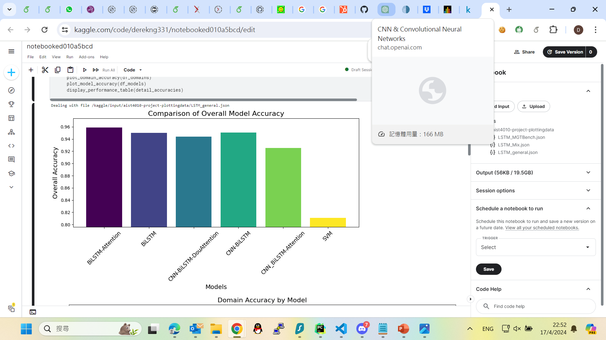
Result – M4 Analysis
BiLSTMAttention outperforms all other models in terms of different criteria.
BiLSTM series models outperform SVM

Slide 14
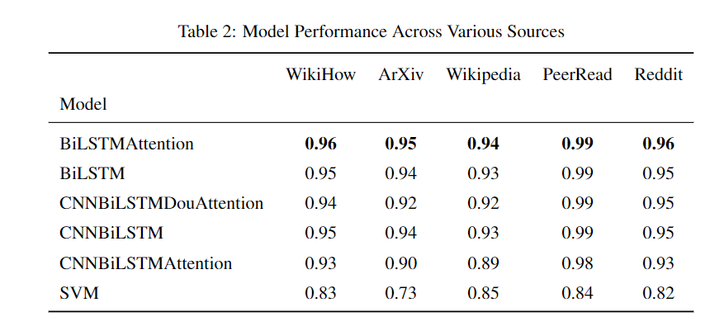
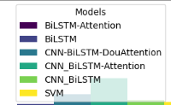
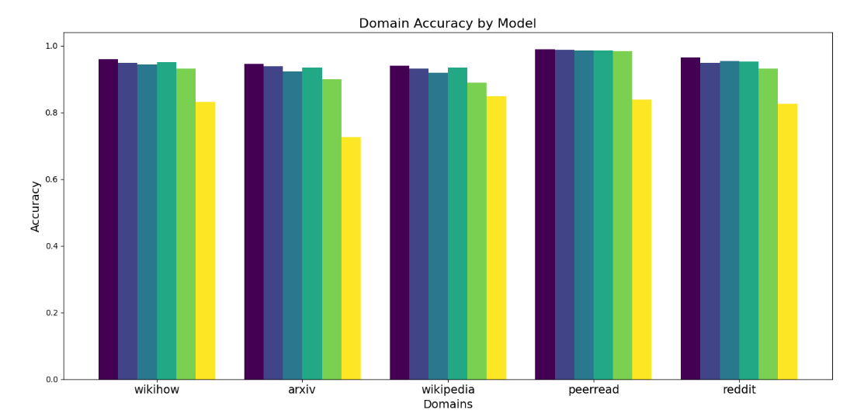
Result – M4 Analysis
Similar result shown, but all models perform the best in PeerRead. And the worst in Wiki data.

Slide 15
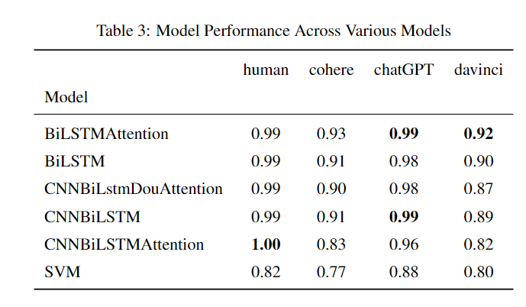
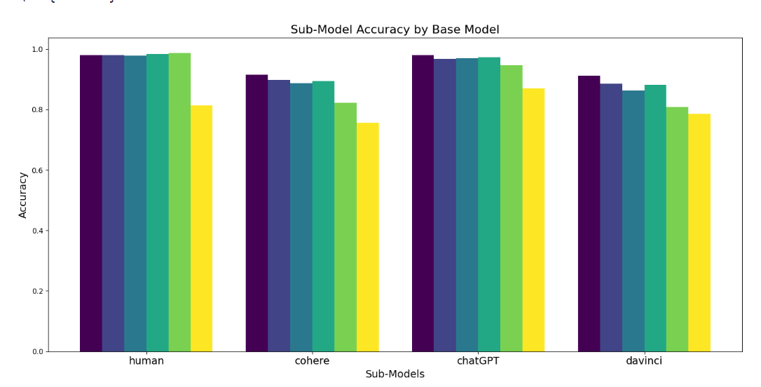
Result – M4 Analysis
There’s a gap of performance between (Human, ChatGPT) and (Cohere, davinci)

Slide 16
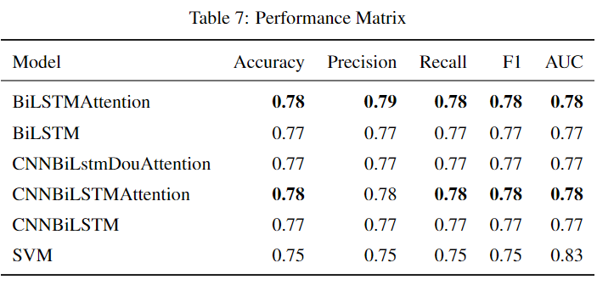
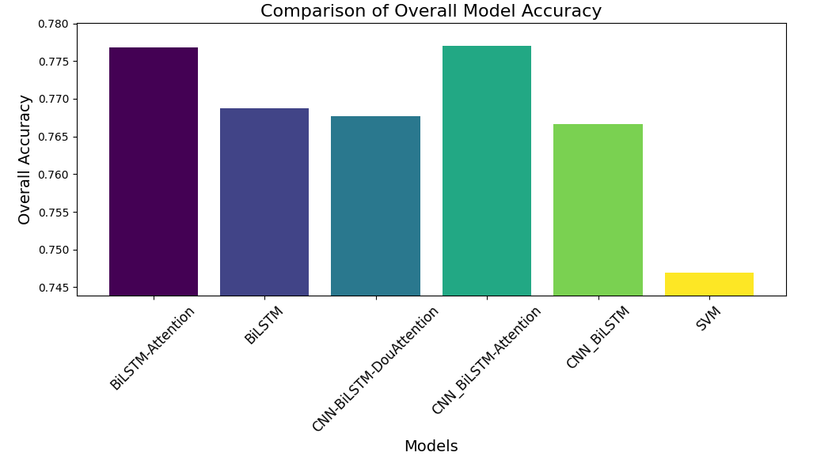
Result – MGTBench Analysis
Similar result in M4 analysis.
Large drop of performance in different criteria.
SVM still perform the worst among all baselines.

Slide 17
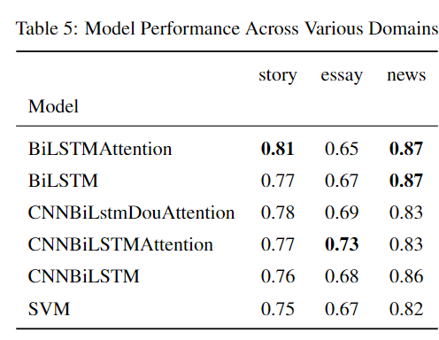
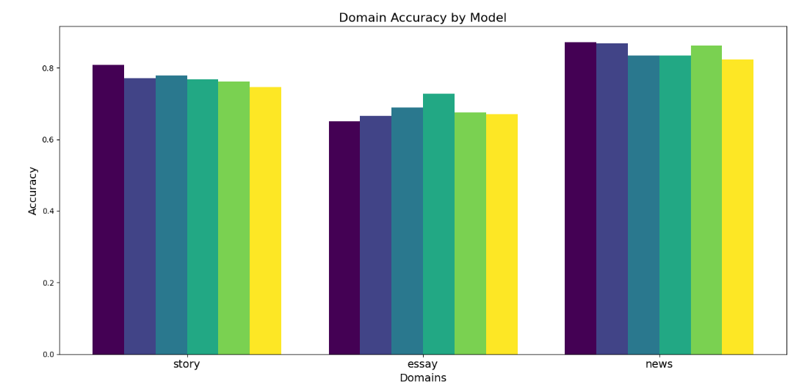
Result – MGTBench Analysis
Perform decent in news and story, while poorly in essay data.

Slide 18
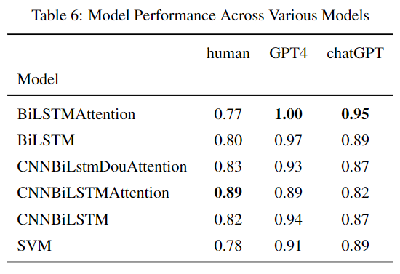
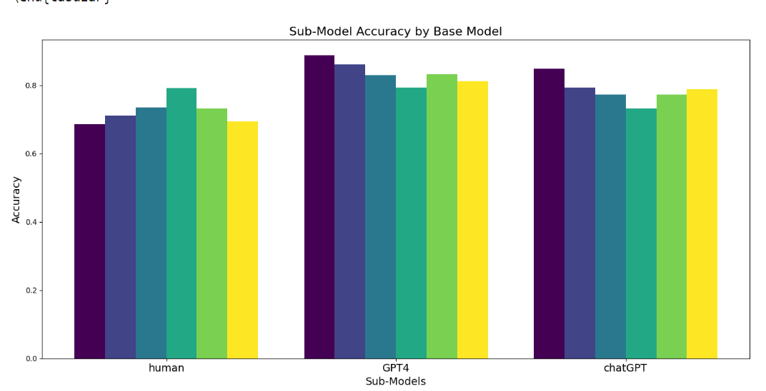
Result – MGTBench Analysis
The model can perform well on data generated from ChatGPT and even GPT4.
The performance drop may be because of human data.

Slide 19
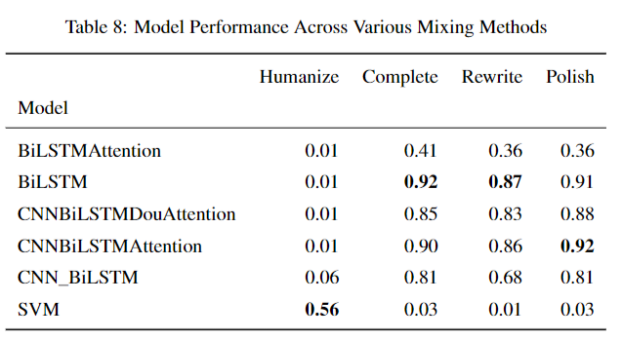
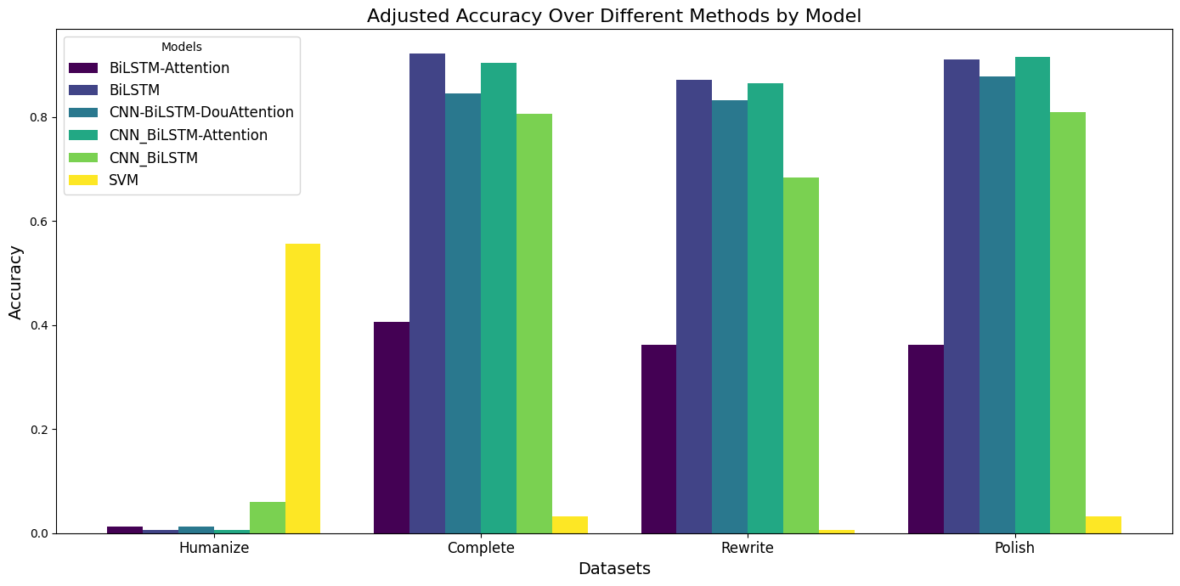
Result – MixSet Analysis
The BiLSTM series models perform well on 3 /4 mixing methods.
While BiLSTM-Attention is just random guessing.
While SVM performed extremely poor in this dataset.
There’s a large gap between “Humanize” and other mixing methods.

Slide 20
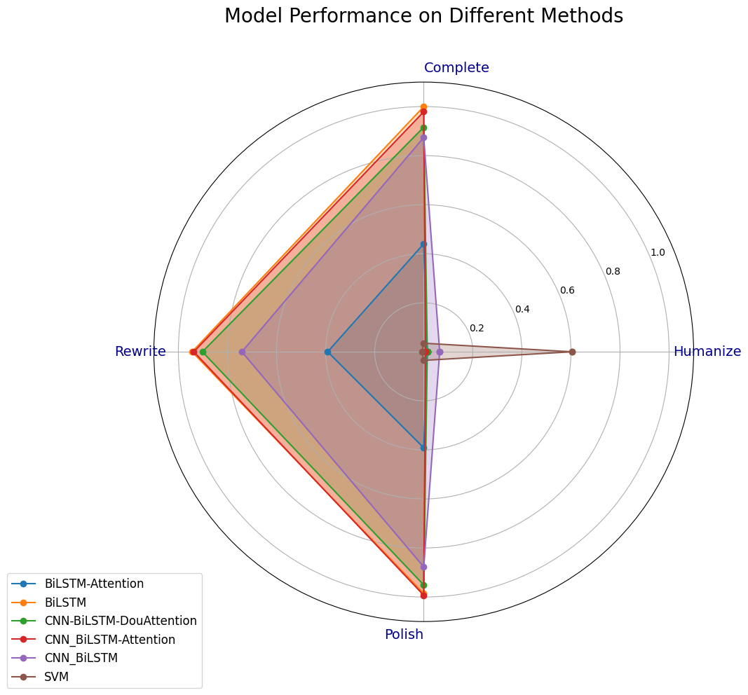

Slide 21
Conclusion
In this project, there are few questions want to solve:
Can those models detect the trending LLM generated data well? -> Yes
Would they mislabel the HWT into MGT? -> Easily occurred in MGTBench data.
Are there any performance difference in detecting the pure data and mixed data? -> Depends on the Mixing method

